Slide 1
Get to know your benefits
Kinex Medical Company
Benefits effective 1/1/2024

Slide 2
Knowing your benefits helps you make more informed health care decisions
EI20409450.1
Notes:
Intro
Knowing your benefits helps you make more informed health care decisions. As a member, you’ll receive tools and support to help you save time and money—and find care when you need it. Here are just a few benefits you can expect from your chosen plan.

Slide 3
Common health terms
Copayment: A fixed amount of money you pay a provider for a covered visit or prescription
Deductible: The amount you’ll need to pay before your plan starts to pay for covered services
Coinsurance: The percentage you pay as your share of a covered health care service
Out-of-pocket limit: The most you could pay during a coverage period (usually 1 year) for your cost share of covered services. After you meet this limit, the plan will usually pay 100% of the allowed amount
justplainclear.com
For thousands of health care terms
defined simply and clearly, this is your site.
EI20409450.1
Notes:
Some health insurance terms can be unfamiliar or hard to understand. Let’s go over a few key terms that will help you understand how your plan works.
Copayment
This is a fixed amount of money you pay a provider for a covered visit or prescription.
Deductible
This is the amount you’ll need to pay before your plan starts paying for covered services.
Coinsurance
Your share of the cost of a covered health care service, calculated as a percentage.
Out-of-pocket limit
The most you could pay during a coverage period (usually 1 year) for your cost share of covered services. After you meet this limit, the plan will usually pay 100% of the allowed amount. The out-of-pocket limit includes all of your network payments.
For thousands of health care terms defined simply and clearly, visit justplainclear.com.

Slide 4
Medical Plan
Effective 1/1/2024
EI20443298.1
Notes:
Core Slide
Thank you for joining me today to learn about the medical plans offered by us and your employer. This presentation is a brief overview of the coverage and I’ll be happy to answer any questions at the end of the presentation.

Slide 5
How a typical health plan works
Let’s take a look at an example of how a typical plan works when you receive care from a network provider. Your plan may be different than this example, so to find your specific details go to myuhc.com > Coverage & Benefits.
Plan start
Deductible reached
Out-of-pocket limit met
You pay 100%*
You pay
20%
Your plan pays
80%
Your plan pays 100%
At the start of your plan year, you pay 100% of your covered health services until you meet your deductible, which is the amount you pay before your plan starts sharing costs.
Now, your health plan starts to share a percentage of the costs with you
— this is your coinsurance.*
Here, your plan’s got you covered at 100%. Your out-of-pocket limit is the most you could pay for covered services in a plan year — copays, coinsurance and deductibles count toward this.
Some plans may require you to pay a fixed amount — or copay — each time you see a provider.
Every plan has a premium, a routine payment
typically taken out of your paycheck to keep your plan
active — so you stay covered.
* Your deductible and coinsurance may vary by plan or service. This example is for illustrative purposes only. These plans have exclusions, limitations and reduction of benefits. For costs and complete details contact your employer.
EI20409450.2
Notes:
Here’s how a typical health plan works when using a network provider.
At the start of your plan year, you pay 100% of covered health services until you meet your deductible - the amount you’ll need to pay before your plan starts to share costs for covered services. When you meet your deductible, then your health plan starts to share a percentage of the costs. This is called coinsurance. In this example, when you reach your deductible, then the amount your responsible for drops to 20% and your plan pays 80%. When you reach your out-of-pocket limit, which is the most you could pay during a coverage period (usually 1 year), the plan will typically pay 100%. Along the way, you may pay a fixed amount – called a copay – each time you see a provider. The amount that you pay for copays, coinsurance and deductibles counts toward your out-of-pocket limit.
You’ll find details about how your plan works when you register on your personalized member website, myuhc.com.

Slide 6
Your costs
 | Network | Out-of-network
Deductible
Individual | $4,000 | $12,000
Family | $8,000 | $24,000
Out-of-pocket limit
Individual | $6,350 | $19,050
Family | $12,700 | $38,100
Coinsurance *applies after deductible | 20% | 50%
Copayment
Primary care provider (PCP) | 20%* | 50%*
Specialist | 20%* | 50%*
Please read your plan documents. Additional information such as benefit details, plan limitations and exclusions, and the costs of coverage can be found in the Summary of Benefits.
EI20443298.1
UnitedHealthcare Insurance Company
Notes:
This table summarizes the costs associated with your plan.

Slide 7
Digital tools to manage your plan
Find and estimate costs, check what’s covered, search providers, view plan balances, and see claim details with UnitedHealthcare’s digital tools: myuhc.com® and UnitedHealthcare® app.
EI20409450.2
Notes:
​To play this video, click on the thumbnail which will open the video in an internet browser. Once the video is finished, return to slideshow to resume your presentation. To include sound during a Teams meeting, make sure to click the ‘include computer sound’ button.
Runtime: 1:28

Slide 8
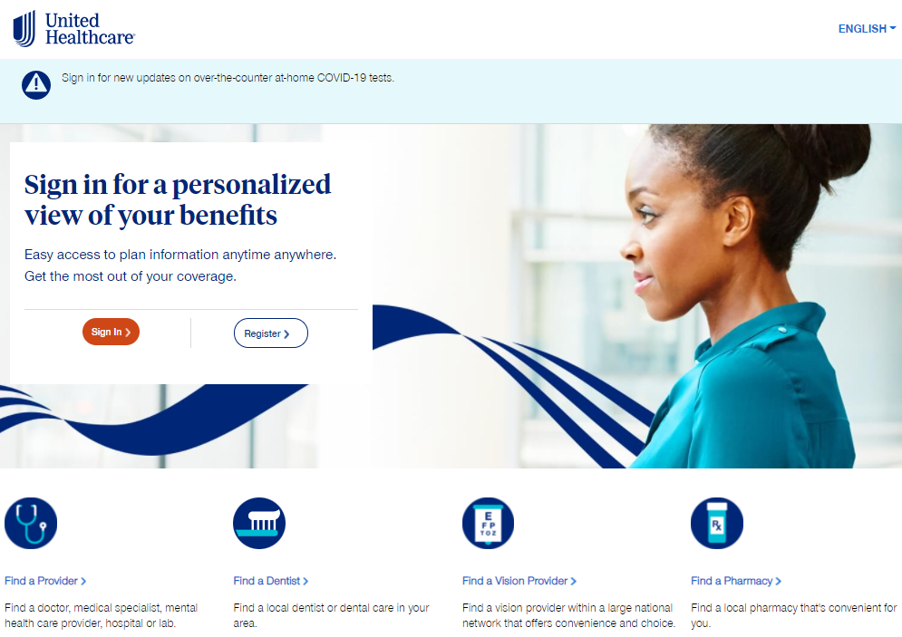
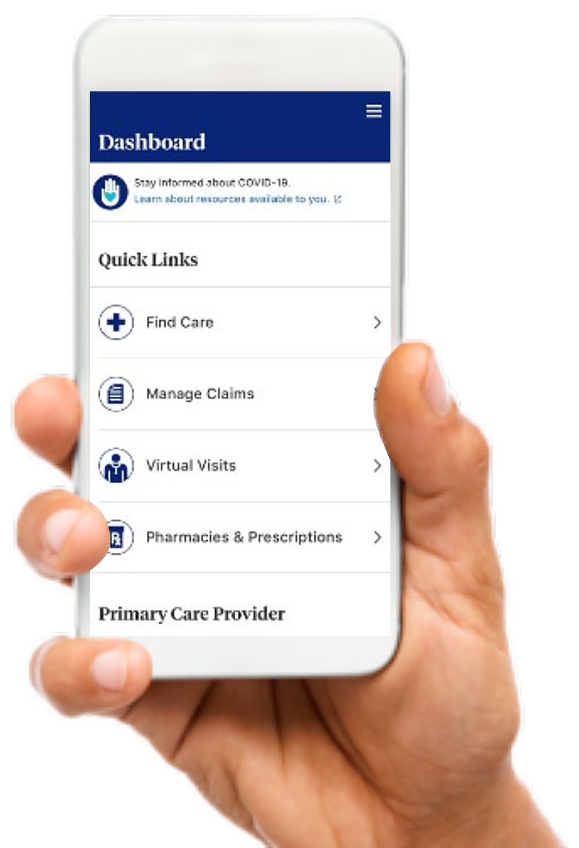
Two convenient ways to access your plan
Access your account on myuhc.com® or the UnitedHealthcare® app after enrolling to:
Find and estimate the cost of care
See what’s covered
View claim details and check plan balances
Find network doctors and pharmacies
Order prescriptions
Video chat with a doctor 24/7
View and share your health plan ID card
Download the app
Members can access a cost estimate online or on the mobile app. None of the cost estimates are intended to be a guarantee of your costs or benefits. Your actual costs may vary. When accessing a cost estimate, please refer to the Website or Mobile application terms of use under Find Care & Costs section. The UnitedHealthcare® app is available for download for iPhone® or Android®. iPhone is a registered trademark of Apple, Inc. Android is a registered trademark of Google LLC. Apple, App Store and the Apple logo are trademarks of Apple Inc., registered in the U.S. and other countries. Google Play and the Google Play logo are registered trademarks of Google Inc.
EI232260752
Notes:
Access your plan easily with myuhc.com® or with the UnitedHealthcare® app
With myuhc.com, you’ve got your own personalized member website built to help you manage your health plan 24/7. Search for a network doctor, find and price the care you need before you go, view claims details, manage your financial accounts and so much more. Once you are a member, please register and learn more at myuhc.com. You can:
•Find and estimate the cost of care
•See what’s covered
•View claim details
•Check your plan balances
•Find network doctors [and pharmacies]
•[Order prescriptions]
With the UnitedHealthcare® app you have the same access to all of the great benefits of myuhc.com right from your pocket including quick access to your ID card while at the office, and even the ability to have a Virtual Visit right within the App.

Slide 9
Check if your provider is in the network
To find out if your preferred providers are included:
1
Go to uhc.com/providersearch
2
When asked what type of provider you are looking for, select Medical Directory
3
Next, select Employer and Individual Plans
4
Choose the Choice Plus health plan and add your location to view providers in the network
EI221836753.0
Notes:
A network is a group of providers and facilities who’ve been contracted to deliver health care services, often at a discount. Getting care from within the network may help you save money. If there’s a provider you see regularly and want to keep seeing, it’s a good idea to first make sure they’re in the plan’s network.
To find out if your preferred providers are included:
Go to uhc.com/providersearch
When asked what type of provider you are looking for, select Medical Directory
Next, select Employer and Individual Plans
Choose the Choice Plus health plan and add your location to view providers in the network

Slide 10
Make more informed choices
The UnitedHealth Premium® program uses national, evidence-based measures to evaluate physicians in multiple specialties to help you make more informed choices for your medical care. Find UnitedHealth Premium Care Physicians by going to myuhc.com > Find a Provider and look for the blue hearts.
Premium Care Physician
The UnitedHealth Premium® designation program is a resource for informational purposes only. Designations are displayed in online physician directories at myuhc.com®. You should always visit myuhc.com for the most current information. Premium designations are a guide to choosing a physician and may be used as one of many factors you consider when choosing a physician. If you already have a physician, you may also wish to confer with him or her for advice on selecting other physicians. You should also discuss designations with a physician before choosing him or her. Physician evaluations have a risk of error and should not be the sole basis for selecting a physician. Please visit myuhc.com for detailed program information and methodologies.
EI20409450.1
Notes:
The UnitedHealth Premium® program uses national, evidence-based measures to evaluate physicians in multiple specialties to help you make more informed choices for your medical care. Find UnitedHealth Premium Care Physicians by going to myuhc.com > Find a Provider and look for the blue hearts.

Slide 11
24/7 Virtual Visits: Convenient care for zero dollars***
With 24/7 Virtual Visits, providers can treat a wide range of common health conditions by phone or video* — including many of the same ones treated in an emergency room (ER) or urgent care. If needed, providers may even prescribe medications.**
Employees can receive care for:
Cost of a visit is usually
$0
***
Cough
Headache
Sore Throat
And many other conditions
*Data rates may apply. **Certain prescriptions may not be available, and other restrictions may apply. ***The Designated Virtual Visit Provider's reduced rate for a 24/7 Virtual Visit is subject to change.
24/7 Virtual Visits is a service available with a Designated Virtual Network Provider via video, or audio-only where permitted under state law. Unless otherwise required, benefits are available only when services are delivered through a Designated Virtual Network Provider. 24/7 Virtual Visits are not intended to address emergency or life-threatening medical conditions and should not be used in those circumstances. Services may not be available at all times, or in all locations, or for all members. Check your benefit plan to determine if these services are available.
EI232491080
Notes:
With 24/7 Virtual Visits, providers can treat a wide range of common health conditions by phone or video* — including many of the same ones treated in an emergency room (ER) or urgent care. If needed, providers may even prescribe medications.**
Employees can receive care for:
Allergies
Cough
Pink eye
And many other conditions
With certain UnitedHealthcare health plans, the cost of a visit is usually $0.***
Employees can access 24/7 Virtual Visits through myuhc.com® or the UnitedHealthcare® app.

Slide 12
Virtual primary care
Managing your health with a primary care provider (PCP) may be easier when you have more ways to access care.
With virtual primary care, you can see a PCP without having to leave home or work. Connect remotely with a virtual PCP and their team of health care professionals through myuhc.com® or the UnitedHealthcare® app.*
You can see the same virtual PCP for:
Preventive care
Follow-up visits
Checkups for ongoing conditions like asthma, diabetes and more
Benefits of virtual primary care include:
A provider you can see on an ongoing basis
A Care Team who’ll guide you, when needed, to in-person care such as labs, imaging, specialists and more
A Care Team who’ll work with you and follow up to ensure you’re taken care of
*Data rates may apply.
Virtual primary care is applied to primary care benefits — it is not applied to 24/7 Virtual Visits benefit. Not available with all health plans. Due to physician licensing restrictions, virtual primary care is only available within the member’s state of residence. If the member’s location isoutside of their state of residence, virtual visits for primary care will be provided as a 24/7 Virtual Visit provided by Optum Virtual Care.
Virtual primary care are services available with a provider via video, chat, email, or audio-only where permitted under state law. Virtual primary care services are only available if the provider is licensed in the state that the member is located at the time of the appointment. Virtual primary care is not intended to address emergency or life-threatening medical conditions and should not be used in those circumstances. Services may not be available at all times, or in all locations, or for all members. Certain prescriptions may not be available, and other restrictions may apply.
EI221768200.1
Notes:
With virtual primary care, you can establish a virtual relationship with a primary care provider (PCP) – from your computer or mobile device without having to leave home or work. Connect remotely with a virtual PCP and their team of health care professionals through myuhc.com® or the UnitedHealthcare® app.*
Much like traditional in-person care, virtual primary care providers may treat ongoing health concerns and conditions. From wellness screenings to management of diabetes, high blood pressure and asthma to sleep problems.
You can see the same virtual PCP for:
Preventive care
Follow-up visits
Checkups for ongoing conditions like asthma, diabetes and more
Benefits of virtual primary care include:
A provider you can see on an ongoing basis
A Care Team who’ll guide you, when needed, to in-person care such as labs, imaging, specialists and more
A Care Team who’ll work with you and follow up to ensure you’re taken care of
Visits with a virtual primary care provider cost the same as a provider you would see in person. After you become a member, find a primary care provider under virtual care on myuhc.com.
*Data rates my apply.

Slide 13
Make sure everything checks out
Preventive care — such as routine annual checkups and certain recommended screenings and immunizations — is covered by most of our plans for $0 out-of-pocket when you see network providers.
A preventive care visit may be a good time to:
Establish your relationship with your primary care provider
Create a connection for future medical service
Evaluate your health when you’re symptom-free
For more information, check your plan documents.
Certain preventive care items and services, including immunizations, are provided as specified by applicable law, including the Patient Protection and Affordable Care Act (ACA), with no cost-sharing to you. These services may be based on your age and other health factors. Other routine services may be covered under your plan, and some plans may require copayments, coinsurance or deductibles for these benefits. Always review your benefit plan documents to determine your specific coverage details.
EI20409450.1
Notes:
Preventive care — such as routine annual checkups and certain recommended screenings and immunizations — is covered by most of our plans for $0 out-of-pocket when you see network providers. A preventive care visit may be a good time to:
Help establish your relationship with your primary care provider
Create a connection for future medical services
Evaluate your health when you’re symptom-free
Preventive care is routine health care that’s meant to help you stay healthy.
[Presenter’s note: For more information on preventive care, visit www.uhc.com/health-and-wellness/preventive-care]

Slide 14
Pharmacy Benefits
Prescriptions
EI20443294.1
Notes:
Let’s take a look at your pharmacy coverage.

Slide 15
Learn about OptumRx
Medications can play an important role in your health, so it’s good to be in the know about your pharmacy benefits: what they are, how they work and ways they can help you save on costs.
EI20409450.2
Notes:
​To play this video, click on the thumbnail which will open the video in an internet browser. Once the video is finished, return to slideshow to resume your presentation. To include sound during a Teams meeting, make sure to click the ‘include computer sound’ button.
Runtime: 1:44

Slide 16
Easily fill and save on your medications
Access thousands of retail pharmacies
Save when you
use a network
pharmacy
Understand your coverage
limits
Discover home delivery for maintenance
medications
EI20445652.1
Optum Rx® is an affiliate of United HealthCare Insurance Company
Notes:
You’ll be covered for a wide variety of medications. And best of all, we’ve designed it to be it easy for you to get your prescriptions filled and save money.
Get access to thousands of retail pharmacies.
Save when you use a network pharmacy.
[Understand your coverage limits].
[Discover home delivery for maintenance medications].
[Maintenance medications are those medications you take regularly]

Slide 17
No out-of-pocket costs on preferred insulin and other vital drugs
UnitedHealthcare’s Vital Medication Program offers the preferred drugs listed below at no out-of-pocket cost to you:
insulin - rapid, short and long-acting
epinephrine - allergic reactions
glucagon - hypoglycemia (low blood sugar)
naloxone - opioid overuse
albuterol - asthma
If you are not currently enrolled with UnitedHealthcare pharmacy benefit coverage, you may access your health plan’s member website for additional information during your open enrollment period or you may contact your employer or health plan for additional information. Medications are categorized by common therapeutic conditions in this reference guide for ease of reference only. These categories do not determine coverage for the medication for your condition. Your benefit plan determines how these medications may be covered for you. Where differences are noted between this reference guide and your benefit plan documents, the benefit plan documents will govern. This document applies to commercial group members of UnitedHealthcare plans.
EI20445652.2
Optum Rx® is an affiliate of United HealthCare Insurance Company
Notes:
UnitedHealthcare is taking an important step in its continued efforts to make prescription drugs more affordable by eliminating out-of-pocket costs for drugs that are critical to maintaining the health of our members.
UnitedHealthcare’s Vital Medication Program offers the preferred drugs listed below at no out-of-pocket cost to you:
insulin - rapid, short and long-acting
epinephrine - allergic reactions
glucagon - hypoglycemia (low blood sugar)
naloxone - opioid overuse
albuterol – asthma
[Presenter’s note: Members can sign in to myuhc.com to find the program drug list for details.]

Slide 18
Promoting safe and appropriate prescription use
Prior authorization
Requires your doctor to tell us why you’re taking a medication to determine if covered under your plan
To start the process, talk to your doctor or call the number on your ID card
Supply limits
The largest quantity of medication covered per copayment or in a defined time period
Based on FDA guidelines for medication dosage, clinical guidelines or usage patterns
Step therapy*
Step 1 Medications: Proven to be clinically similar and effective
Step 2 Medications: Treats the same condition but may cost more
EI20445652.1
Optum Rx® is an affiliate of United HealthCare Insurance Company
Notes:
There are pharmacy programs in place to promote safe and appropriate prescription drug use.
Some medications require prior authorization because they are only approved or effective in treating specific illnesses. Start the process by asking your doctor to contact the number on your ID card.
Second is supply limits. Supply limits is the largest quantity of medication covered per copayment or in a defined time period. This limit is based on FDA guidelines for medication dosage, clinical guidelines or usage patterns.
And finally, there’s step therapy.* Often there are many therapy options to treat or prevent medical conditions. Step therapy requires you to try 1 or more other medications before a higher cost medication may be covered.

Slide 19
How prescriptions are covered
The UnitedHealthcare Prescription Drug List (PDL) is a list of commonly prescribed medications covered by the plan. Medications are placed into tiers that represent the cost you pay out of pocket.
Cost
Value
Tier 1
Lower-cost medications
Highest overall value
Mostly generics
Tier 2
Mid-range cost
Good overall value
Mix of brands and generics
Tier 3
Higher-cost medications
Lowest overall value
Mostly brands
EI20445652.1
Optum Rx® is an affiliate of United HealthCare Insurance Company
Notes:
[Presenter note: Without costs]
The Prescription Drug List (PDL) is the list of commonly prescribed medications covered by the plan. The PDL is organized by cost levels, known as tiers. Choosing medications in the lower tiers may save you money.
We evaluate all medications to determine coverage and tier placement. When there are several similar medications that treat the same condition, we may not cover all of them. So, you may need to switch. Check the PDL to confirm which option may be covered.

Slide 20
How prescriptions are covered
The Prescription Drug List (PDL) is a list of commonly prescribed medications covered by the plan. Medications are placed into tiers that represent the cost you pay out of pocket.
Tier 1 | 20%*
Tier 2 | 20%*
Tier 3 | 20%*
*after deductible
EI20445652.2
Optum Rx® is an affiliate of United HealthCare Insurance Company
Notes:
The Prescription Drug List (PDL) is a list of commonly prescribed medications that are covered by the plan. The PDL is organized by cost levels, known as tiers. Choosing medications in the lower tiers may save you money.

Slide 21
Advantage of using home delivery
Free shipping
Get up to a 3-month supply for medications you take regularly
May cost less than retail pharmacy
Refill reminders and 24/7 access to a pharmacist
24/7 pharmacist access for questions about your medications
EI20445652.2
Optum Rx® is an affiliate of United HealthCare Insurance Company
Notes:
Save on your medications with Optum Rx home delivery.
If you choose to receive your prescriptions by mail, you could:
Save a trip to the pharmacy with free shipping
Get up to a 3-month supply for medications you take regularly through theThe Preferred 90 Program – allows 90-day supply of maintenance medications through Optum Rx® home delivery, CVS or Walgreens retail locations.] [Preferred 90 is for Fully Insured members only]
May cost less than you would at a retail pharmacy
Get 24/7 pharmacist access for questions about your medications.
Receive refill reminders. [Can easily manage through myuhc.com or UnitedHealthcare app as previously mentioned.]​

Slide 22
Benefits designed to help you stay healthier
EI20445653.1
Notes:
Thank you for taking the time to learn more about your health and wellness benefits.

Slide 23
Get in on UHC Rewards
What’s better than earning rewards for reaching goals and taking care of your health? Being able to choose how those rewards are earned. With UnitedHealthcare Rewards, you can earn up to $300. And get this: UHC Rewards is included in your health plan at no additional cost. Here are some ways you can earn:
Completing a health survey
Getting an annual checkup
Tracking your fitness and sleep
UnitedHealthcare Rewards is a voluntary program. The information provided under this program is for general informational purposes only and is not intended to be nor should be construed as medical advice. You should consult an appropriate health care professional before beginning any exercise program and/or to determine what may be right for you. Receiving an activity tracker, certain credits and/or rewards and/or purchasing an activity tracker with earnings may have tax implications. You should consult with an appropriate tax professional to determine if you have any tax obligations under this program, as applicable. If any fraudulent activity is detected (e.g., misrepresented physical activity), you may be suspended and/or terminated from the program. If you are unable to meet a standard related to health factor to receive a reward under this program, you might qualify for an opportunity to receive the reward by different means. You may call us toll-free at 1-866-230-2505 or at the number on your health plan ID card, and we will work with you (and, if necessary, your doctor) to find another way for you to earn the same reward. Rewards may be limited due to incentive limits under applicable law. Components subject to change. This program is not available for fully insured members in Hawaii, Vermont and Puerto Rico nor available to level funded members in District of Columbia, Hawaii, Vermont and Puerto Rico.
EI221811304.3
Notes:
What’s better than earning rewards for reaching goals and taking care of your health? Being able to choose how those rewards are earned. With UnitedHealthcare Rewards, you can earn up to <$300/$1,000/$X>. And get this: UHC Rewards is included in your health plan at no additional cost. Here are some ways you can earn:
Completing a health survey
Getting an annual checkup
Tracking your fitness and sleep
Once you are a member, check out UnitedHealthcare Rewards on the UnitedHealthcare app or at myuhc.com to personalize your experience by selecting reward activities that are right for you.

Slide 24
Flexible fitness options, starting at less than $1 per day
With One Pass Select™, we’re on a mission to make fitness engaging. Find a routine that’s right for you and choose a membership tier that fits your lifestyle.
One Pass Select includes:
Access to a large gym network
Any location in your network tier at no additional cost
The option to change tiers monthly
The ability to add up to four adult members (18+) to an existing account
The option to cancel your membership at any time by giving a 30-day notice
One Pass Select is a voluntary program. For fully insured participants (not available in HI, KS, VT and Puerto Rico) it features a subscription based nationwide gym network and digital fitness. For self-funded participants nationally, it features a subscription based nationwide gym network, digital fitness and grocery delivery service. The information provided under this program is for general informational purposes only and is not intended to be nor should be construed as medical advice. Individuals should consult an appropriate health care professional before beginning any exercise program and/or to determine what may be right for them. Purchasing discounted gym and fitness studio memberships, digital fitness or grocery services may have tax implications. Employers and individuals should consult an appropriate tax professional to determine if they have any tax obligations with respect to the purchase of these discounted memberships or services under this program, as applicable. One Pass Select is a program offered by Optum. Subscription costs are payable to Optum.
EI232679760.0
Notes:
With One Pass Select™, we’re on a mission to make fitness engaging. Find a routine that’s right for you and choose a membership tier that fits your lifestyle.
One Pass Select includes:
Access a large gym network, including national fitness centers and boutique studios
Any location in your network tier at no additional cost
The option to change tiers monthly to create a routine that fits your lifestyle
The ability to add up to four adult members (18+) to an existing account. New members can select any membership tier, and you’ll receive a 10% discount on their memberships.
The option to cancel your membership at any time by giving a 30-day notice

Slide 25
Healthier habits, healthier lifestyle
Take small steps for lasting change with Real Appeal®, an online weight management support program. It’s designed to help you live a healthier life with online coaching, access to online fitness content, tools to track your progress and more
Online coaching
Encouragement from an online coach to help create healthy, lasting change
Success Kit
Weight and food scales, recipes, fitness equipment and more delivered to your door
Motivational resources
Set achievable nutrition, exercise and weight management goals that keep you motivated to create lasting change
Real Appeal is a voluntary weight management program that is offered to eligible members at no additional cost as part of their benefit plan. The information provided under this program is for general informational purposes only and is not intended to be nor should be construed as medical and/or nutritional advice. Participants should consult an appropriate health care professional to determine what may be right for them. Results, if any, may vary. Any items/tools that are provided may be taxable and participants should consult an appropriate tax professional to determine any tax obligations they may have from receiving items/tools under the program.
EI20445653.2
Notes:
Everything you need to help you lose weight and keep it off.
Whether you want to lose a lot of weight or just a few extra pounds, try Real Appeal®, an online weight loss program focused on making small changes to help you live a healthier life. It includes:
Online coaching: Encouragement from an online coach to help create healthy, lasting change
Success Kit: Weight and food scales, recipes, fitness equipment and more delivered to your door
Motivational resources: Set goals and track progress, stream workouts and more with your online dashboard
[Presenter’s note: Learn more about Real Appeal at myuhc.com on the health resources tab.]

Slide 26
Quit tobacco for good
Quit For Life is a program that’s designed to help you overcome tobacco or nicotine, including smoking and vaping. The Quit For Life® program includes:
Online tools, resources and a Live Tobacco-Free course
Support from a Quit Coach®, who can help you create a personalized Action Plan
Quit For Life mobile app, with 24/7 urge management support
Text2Quit® text messages for daily tips and encouragement
Get the tips, tools and personal support you may need to quit your way
The Quit For Life Program provides information regarding tobacco cessation methods and related well-being support. Any health information provided by you is kept confidential in accordance with the law. The Quit For Life Program does not provide clinical treatment or medical services and should not be considered a substitute for your doctor’s care. Please discuss with your doctor how the information provided is right for you. Participation in this program is voluntary. If you have specific health care needs or questions, consult an appropriate health care professional. This service should not be used for emergency or urgent care needs. In an emergency, call 911 or go to the nearest emergency room.
EI20445653.2
Notes:
With a coach on your side, it may be easier to leave tobacco behind. The Quit For Life program includes online support, a customized action plan and more to help you go tobacco-free.

Slide 27
Supporting you and your emotional well-being
With Behavioral Health Solutions get connected to self-help digital tools, behavioral health providers (in-person or virtual) and other resources that can help with a variety of concerns such as:
Depression, stress and anxiety
Relationship difficulties
Coping with grief and loss
Alcohol and drug use recovery
Medication management
Meditation, mindfulness and stress relief
Compulsive habits and eating disorders
Get legal or financial assistance
EI20445653.2
Notes:
Supporting you and your emotional well-being.
With Behavioral Health Solutions get connected to self-help digital tools, behavioral health providers (in-person or virtual) and other resources that can help with a variety of concerns such as:
Depression and anxiety
Relationship difficulties
Coping with grief and loss
Alcohol and drug use recovery
Medication management
Meditation, mindfulness and stress relief
Compulsive habits and eating disorders (Recovery Record mobile app available to all members)
Alcohol and drug use recovery
Get legal or financial assistance

Slide 28
It helps to have someone to talk to
The Employee Assistance Program (EAP) gives you confidential 24/7 support to help with:
Depression, stress and anxiety
Relationship difficulties
Child and elder care support
Substance use disorder and recovery
Financial and legal resources, included in your plan at no initial cost
Learn more at uhc.com/eap
or
call the member phone number on your health plan ID card
The material provided through the Employee Assistance Program (EAP) is for informational purposes only. EAP staff cannot diagnose problems or suggest treatment. EAP is not a substitute for your doctor’s care. Employees are encouraged to discuss with their doctor how the information provided may be right for them. Your health information is kept confidential in accordance with the law. EAP is not an insurance program and may be discontinued at any time. Due to the potential for a conflict of interest, legal consultation will not be provided on issues that may involve legal action against UnitedHealthcare or its affiliates, or any entity through which the caller is receiving these services directly or indirectly (e.g., employer or health plan). This program and its components may not be available in all states or for all group sizes and is subject to change. Coverage exclusions and limitations may apply.
EI20445653.9
Notes:
It helps to have someone to talk to. The Employee Assistance Program (EAP) gives you confidential 24/7 support to help with:
Depression, stress and anxiety
Relationship difficulties
Financial and legal resources
Child and elder care support
Substance use and recovery
And more
Our coordinators are available 24/7 for no additional cost, confidential conversations and referrals to expert care and services.
[Presenter’s note: Members can learn more by visiting www.uhc.com/eap or call the member phone number on their health plan ID card and ask to speak with an EAP consultant.]

Slide 29
Support for when you feel stressed or overwhelmed
Get access to self-care techniques, coping tools, meditations and more — anytime, anywhere and at no additional cost with your health plan. With Self Care, you’ll get personalized content that’s designed to help you boost your mood and shift your perspectives. Tap into clinician-created tools, including:
Daily mood tracking to help you identify patterns and self-assess progress
Meditation tools and methods for relaxation, like deep breathing and positive visualization
A personalized roadmap to help track your progress, set goals and more
The AbleTo mobile application should not be used for urgent care needs. If you are experiencing a crisis or need emergency care, call 911 or go to the nearest emergency room. The Self Care information contained in the AbleTo mobile application is for educational purposes only; it is not intended to diagnose problems or provide treatment and should not be used on its own as a substitute for care from a provider. AbleTo Self Care is available to members ages 13+ at no additional cost as part of your benefit plan. Self Care is not available for all groups in District of Columbia, Maryland, New York, Pennsylvania, Virginia or West Virginia and is subject to change. Refer to your plan documents for specific benefit coverage and limitations or call the toll-free member phone number on your health plan ID card. Participation in the program is voluntary and subject to the terms of use contained in the mobile application.
EI221811305.1
Notes:
Get access to self-care techniques, coping tools, meditations and more — anytime, anywhere and at no additional cost with your health plan. With Self Care, you’ll get personalized content that’s designed to help you boost your mood and shift your perspectives. Tap into clinician-created tools, including:
Daily mood tracking to help you identify patterns and self-assess progress
Meditation tools and methods for relaxation, like deep breathing and positive visualization
A personalized roadmap to help track your progress, set goals and more
It’s all here to help support your self-guided journey to better mental health.

Slide 30
Talk to an Advocate
Understand your benefits and claims
Talk through your bill or payment
Find and compare care and cost options
Get answers to your pharmacy questions
Maximize your health savings
Take advantage of all your plan’s health and well-being benefits
Advocate4Me® should not be used for emergency or urgent care needs. In an emergency, call 911 or go to the nearest emergency room. The information provided through the program is for informational purposes only and provided as part of your health plan. Wellness nurses, coaches and other representatives cannot diagnose problems or recommend treatment and are not a substitute for your doctor’s care. Your health information is kept confidential in accordance with the law. The program is not an insurance program and may be discontinued at any time. Additionally, if there is any difference between this information and your coverage documents (Summary Plan Description, Schedule of Benefits, and any attached Riders and/or Amendments) your coverage documents govern.
EI20445653.1
Notes:
Once you’re enrolled, you can quickly connect with an Advocate over the phone or using the UnitedHealthcare® app - for information and support to help you understand your benefits and claims, make more informed decisions about your health and access the care that helps fits your needs. Advocates are available Monday through Friday during business hours.

Slide 31
Questions?
whyuhc.com/choiceplus
Already a member? Visit myuhc.com
Insurance coverage provided by or through UnitedHealthcare Insurance Company or its affiliates. Administrative services provided by United HealthCare Services, Inc. or their affiliates.
EI20409450.1
Notes:
To learn more, visit us online.

